Slide 1
Data Available
Data​ | Collected From​ | Collected Till​ | Collection Frequency​ | % Missing data​
DCS BA_106 | 06-01-2021 | 31-05-2022​ | Hourly basis | NA ​
DCS Additional BA_106 | 06-01-2021 | 31-05-2022 | Hourly basis | NA
TMT | 07-01-2021 | 13-06-2022 | Daily basis
Dimensions of the available dataset – The dataset has 12384 samples/records and 71 features/variables

Slide 2
Active Run Data Availability
Based on the Naphtha Feed availability, active run state of the furnace is decided. In the sample space where feed availability is nearly zero, considered as offline state of the furnace.
Data | Available From | Available Till | Frequency | Treatment Performed
DCS BA_106 | 06-01-2021 | 02-05-2022 | Hourly Basis | Samples/ Records having naphtha feed as nearly zero are dropped from the sample space.
DCS Additional BA_106 | 06-01-2021 | 02-05-2022 | Hourly Basis
Dimensions of the available dataset – The dataset has 11553 samples/records and 71 features/variables
NOTE: Now the sample space is not continuous time series data as offline records are dropped.

Slide 3
Historical Furnace Run Length Analysis
The sample space is consist of 15 active run information. Average run length for the historical samples is 32 days.

Slide 4
TMT Data Analysis
Parameters | Missing records | % | Treatment Done
TMT Coil 1 | 96 | 0.08 | Since, TMT samples are collected on daily basis while the state of the furnace is online where as DCS samples are stored in hourly format. Hence TMT is converted in the hourly format. Which leads to the increase in missing values. Mean or median could be used to fill the missing values which might decrease the accuracy. Therefore, KNN imputation technique is used to fill those missing values.
TMT Coil 2 | 96 | 0.08
TMT Coil 3 | 96 | 0.08
TMT Coil 4 | 96 | 0.08
TMT Coil 5 | 96 | 0.08
TMT Coil 6 | 96 | 0.08

Slide 6
New Feature/Variable Creation
Our primary concern is to predict the furnace run length. In other words, how long the furnace is going to run from today.
Since, we had no direct information about the furnace run length in the sample dataset, we have derived relative run length for each cycle until the furnace is taken in offline mode.
The new feature is introduced as ‘Run Length’ in the feature space.
E.g. if total run length of one cycle is 40 and today the furnace is running on 5th day, the relative run length will be 35 days.

Slide 7
Feature Space Correlation Analysis
Correlations computation and further treatment are carried out for the following features
Naphtha Feed from Coil 1 to 6 and Total Naphtha Feed
COT from Coil 1 to 6 and Average COT
CIT from Coil 1 to 6 and Average CIT
Dilution Steam Ratio from Coil 1 to 6 and Total Dilution Steam Ratio
CIP from coil 1 to 6 and Maximum CIP
Feed Temp 1 and 2
TMT from Coil 1 to 6 and Max TMT

Slide 8
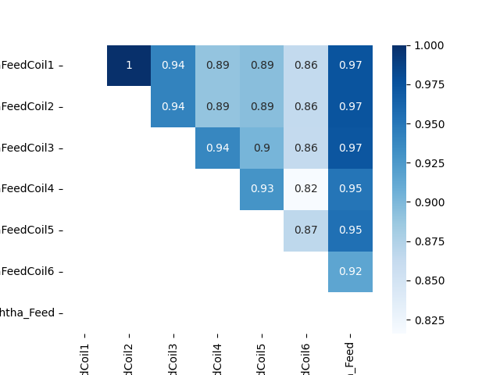
Naphtha Feed Correlation Analysis
The sample dataset is having 6 columns (individual Naphtha Feed coils). Each columns are highly correlated to each other.
Treatment:
Total Naphtha Feed is computed across all the columns.
Since Total Naphtha Feed is highly correlated with all individual columns. Hence individual Naphtha Feed columns are dropped and replaced with Total Naphtha Feed.

Slide 9
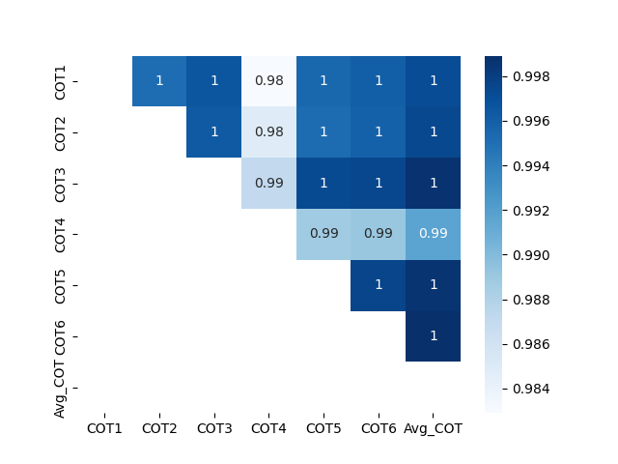
COT Correlation Analysis
The sample dataset consists of 6 columns (individual COT coils). Each columns are highly correlated to each other.
Treatment:
Average COT is computed across all the columns.
Since Average COT is highly correlated with all individual columns. Hence individual COT columns are dropped and replaced with Average COT.

Slide 10
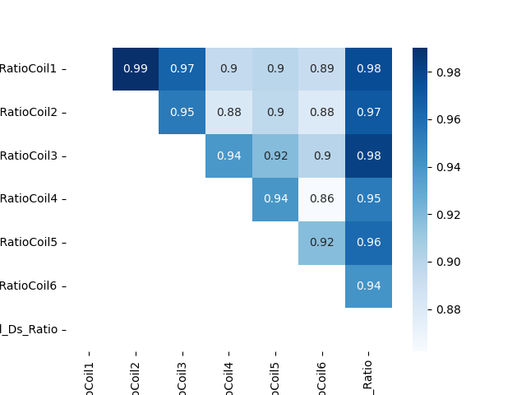
Dilution Steam Ratio Correlation Analysis
The sample dataset consists of 6 columns (individual Dilution Steam coils). Each columns are highly correlated to each other.
Treatment:
Total DS Ratio is computed across all the columns.
Since Total DS Ratio is highly correlated with all individual columns. Hence individual DS Ratio columns are dropped and replaced with Total DS Ratio.

Slide 11
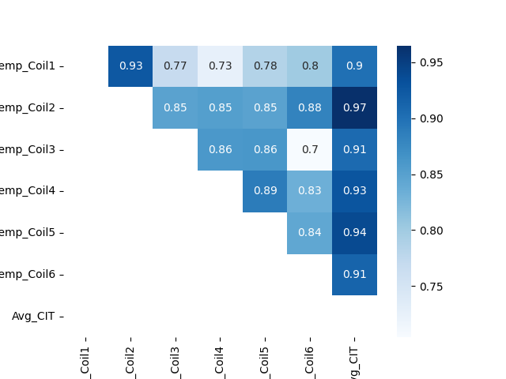
Cross Over Temperature Correlation Analysis
The sample dataset consists of 6 columns (individual CIT coils). Each columns are moderately correlated to each other.
Treatment:
Average Cross Over Temperature is computed across all the columns.
Since Average Cross Over Temperature is highly correlated with all individual columns. Hence average CIT column is not considered as feature.

Slide 12
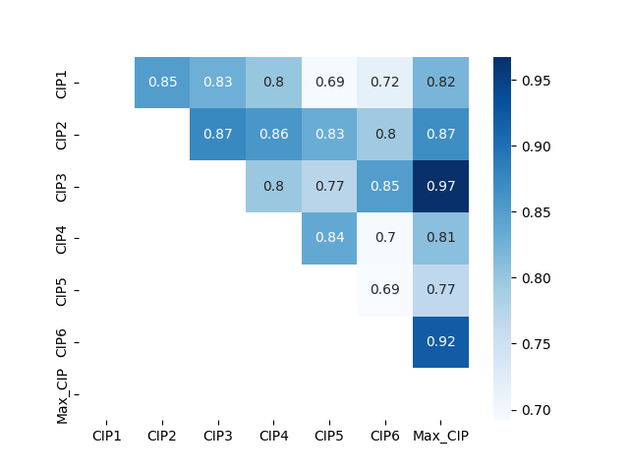
Coil Inlet Pressure Correlation Analysis
The sample dataset consists of 6 columns (individual CIP coils). Though not all the columns are highly correlated to each other, they are having correlation value greater than 0.75. This implies those individual column samples can be considered as features.
Treatment:
Maximum CIP is computed across all the columns.
Since maximum CIP is highly correlated with all individual columns. Hence max CIP column is not considered as useful feature.

Slide 13
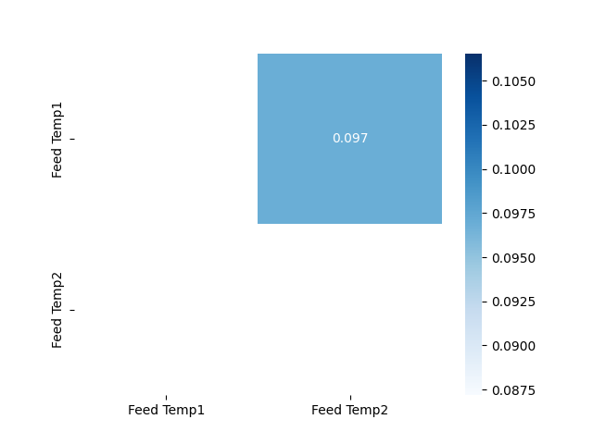
Feed Temperature Correlation Analysis
The sample dataset is having 2 feed temperature columns. Since, there is no significant correlation between feed temp 1 and feed temp 2. Hence individual feed temp columns can be considered as features.
Treatment:
Maximum CIP is computed across all the columns.
Since maximum CIP is highly correlated with all individual columns. Hence individual CIP columns are dropped and replaced with Average Cross Over Temperature.

Slide 14
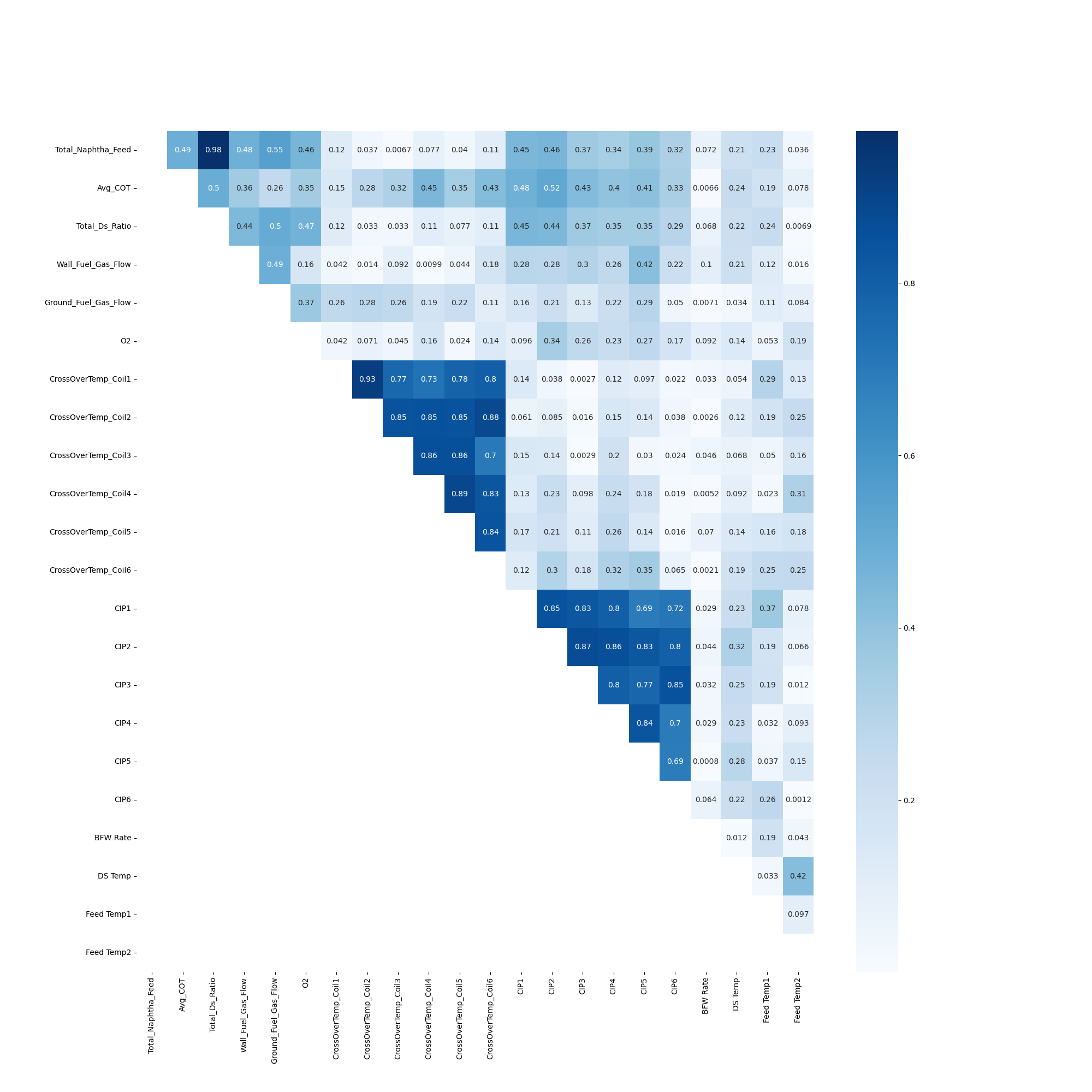
Correlation between final independent variables

Slide 15
From the above heat map it can be observed that some of the sample dataset columns are moderately correlated and some of them are poorly correlated. Also, it can be observed that Total DS ratio is highly correlated
With Total Naphtha feed.
Treatment:
VIF (Variation inflation factor) will be performed to further identify the multicollinearity in the sample independent variables.

Slide 16
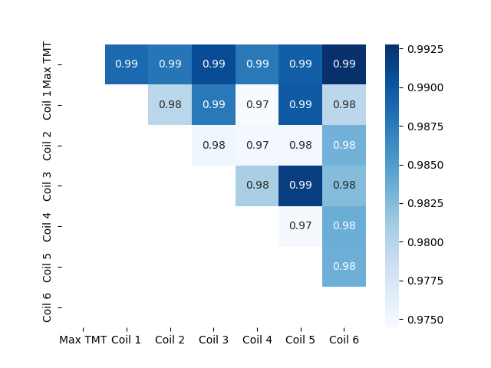
TMT Correlation Analysis
The sample dataset is having 6 columns (individual TMT). Each columns are highly correlated to each other.
Treatment:
As shutdown was usually taken when the TMT reaches the maximum temperature of . Hence, Max TMT is computed across all the columns.
Since Max TMT is highly correlated with all individual columns. Hence individual TMT columns are dropped and replaced with Max TMT.

Slide 17
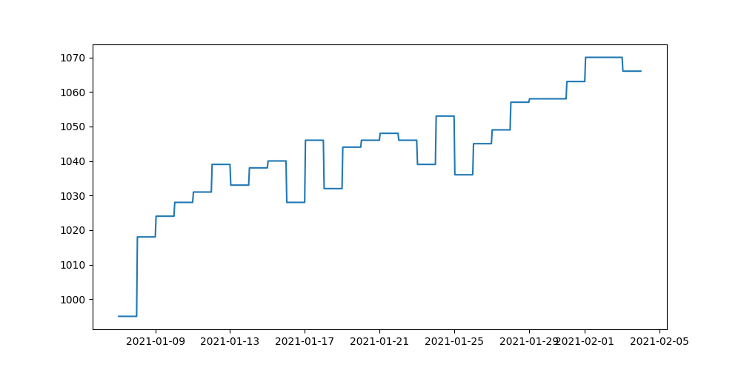
Typical TMT vs Time
The graph is for a single active run (e.g. Run 1) where the furnace is in working states.
TMT is gradually increasing w.r.t time until the decoking starts.

Slide 18
Correlation with Max TMT

